Slide 1

Sistemi Wearable e Telemetria Medica
A.A 2024-25
(Final course project)
Wireless UHF RFID based bladder pressure sensor
Laboratorio
Elettromagnetismo
Pervasivo
Prof. G. Marrocco
Tutor: Ing. Francesca Nanni
1

Slide 2



Team members
Silvia Gialloreto
Project Manager
WP Prototyping and testing
Domiziana Berardino
WP Anatomical State of art
Alice Bonucci
WP EM Analysis and chip selection
Antonio Giordano
WP Preliminary Design
Valerio Luzi
WP Final design and validation

Slide 3
Work Breakdown Structure (WBS)
BLADDER PRESSURE SENSOR
State of art
EM Analysis and Chip Selection
Preliminary Design
Final Design
Prototyping and Testing
Dimension and Material
Theoretical Model
Antenna Type
Final Simulation
Realization
Implantation Procedures
Link Budget
Impedence Matching
Validation
Measures and Testing
Pressure Range
Chip and Sensor Selection
Results Analysis and Presentation

Slide 4
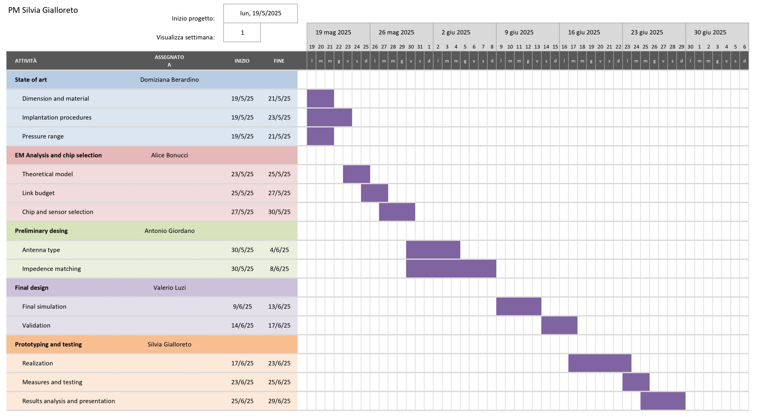
GANTT
Notes:
GAANT

